Slide 1
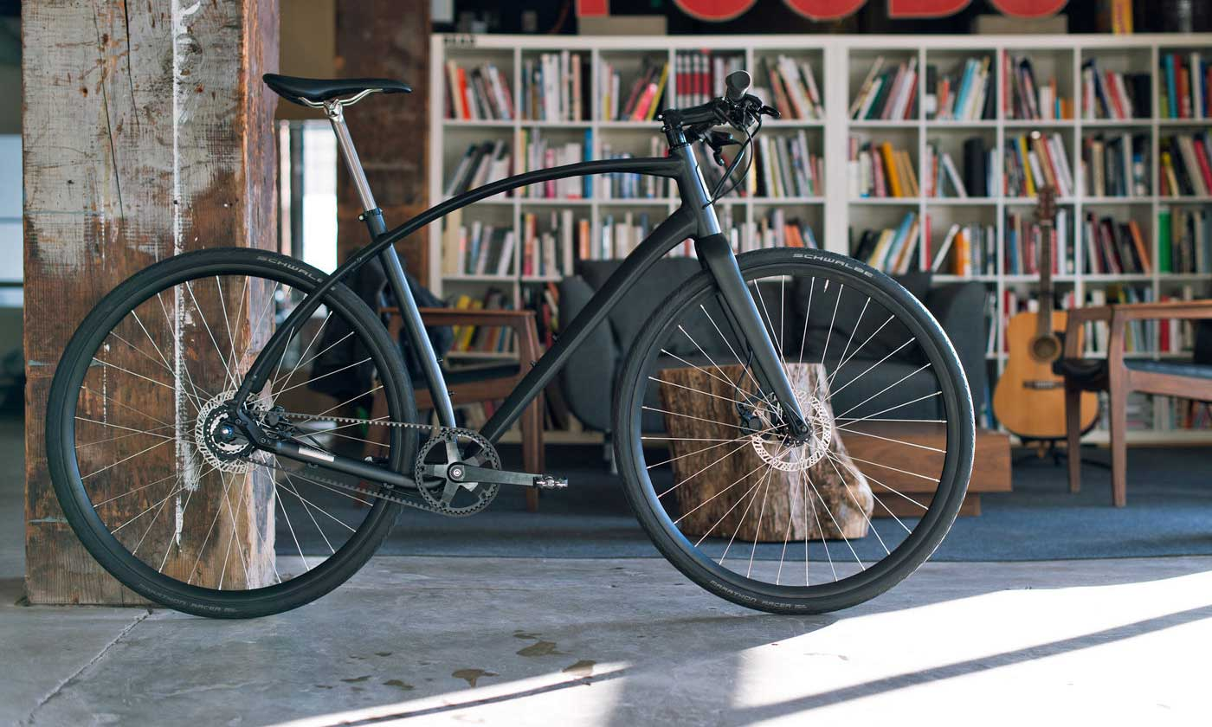

FREDERICTION,
A BIKEABLE CITY ?
FIGHT CLUB

Slide 2

Green and Healthy
Becoming less car-reliant

Slide 3



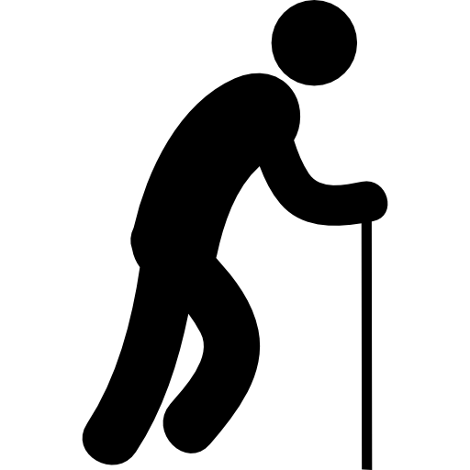



CENSUS TRACT
AGE BREAKDOWN
87%
of labor force commute within Fredericton subdivision
2016
15%
15%
28%
26%
16%
0-14
15-24
25-44
45-64
> 65
69%
of
57,070
TOTAL POPULATION
Source: City of Fredericton
Source: Census 2016, Statistic Canada

Slide 4
Main Mode
of
COMMUTING
Public Transit
4%
Vehicle –
as passenger
Bike
Vehicle – as driver
8%
1%
75%
Other
1%
Walk
9%
Source: Census 2016, Statistic Canada

Slide 5
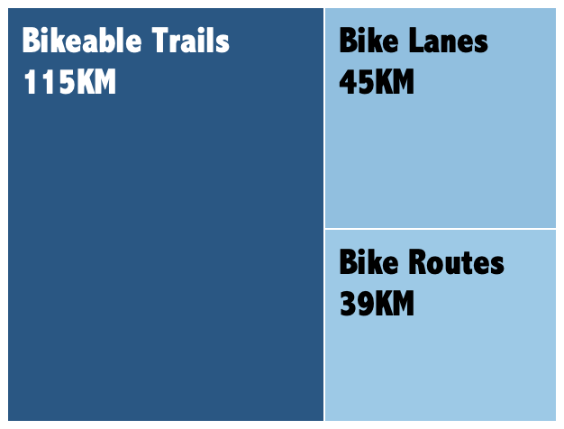
Biking Infrastructure in Fredericton
Source: City of Fredericton

Slide 6
BIKING ACCIDENT
2016
In August 2017:
Police enforced BIKE SAFETY LAWS
Source: City of Fredericton

Slide 7


Over past 11 years
74%
of bike accidents
were at the non – signalized junctions
Credit: Traffic light icon made by Freepik from www.flaticon.com

Slide 8
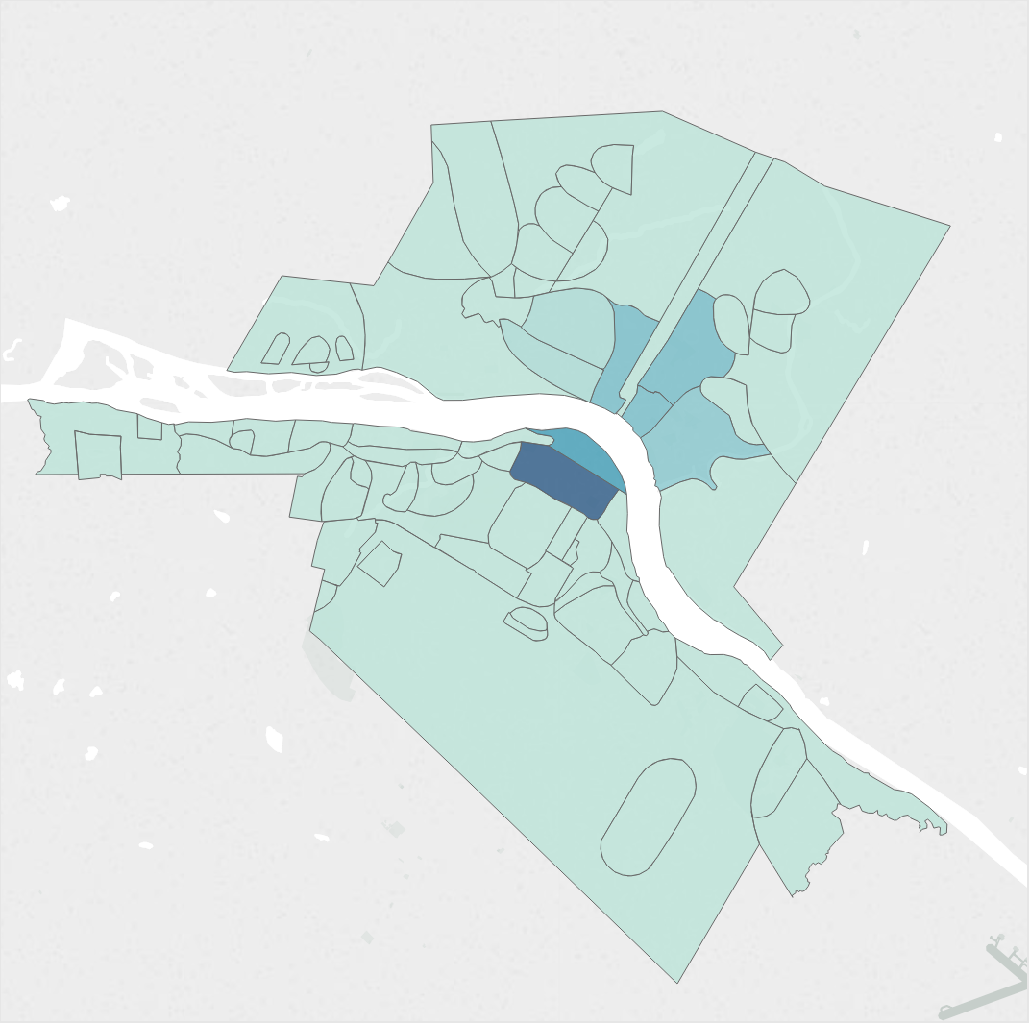
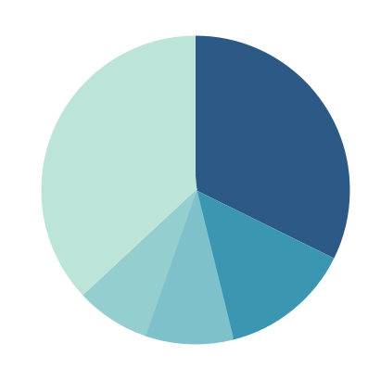
BIKE THEFT BY NEIGHBOURHOOD 2017
Top 4 neighborhoods where BIKE THEFT is likely to occur:
Platt
Downtown
North Devon
South Devon
63% of BIKE THEFTS
HAPPENED IN THESE AREAS
37%
32%
14%
8%
9%
Source: City of Fredericton

Slide 9
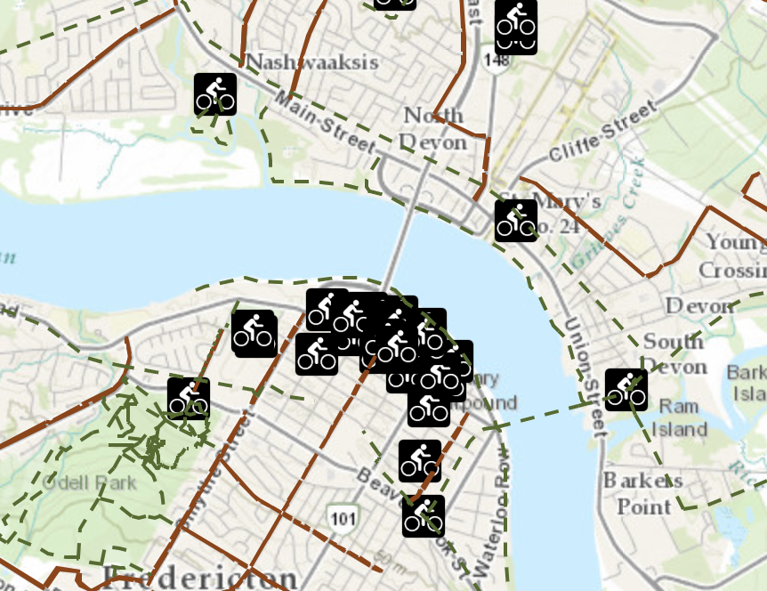
BIKE THEFT BY NEIGHBOURHOOD 2017
Top 4 neighborhoods where BIKE THEFT is likely to occur:
Platt
Downtown
North Devon
South Devon
77% of BIKE RACKS
installed by City of Fredericton are located in THESE NEIGHBOURHOODS
Source: City of Fredericton

Slide 10
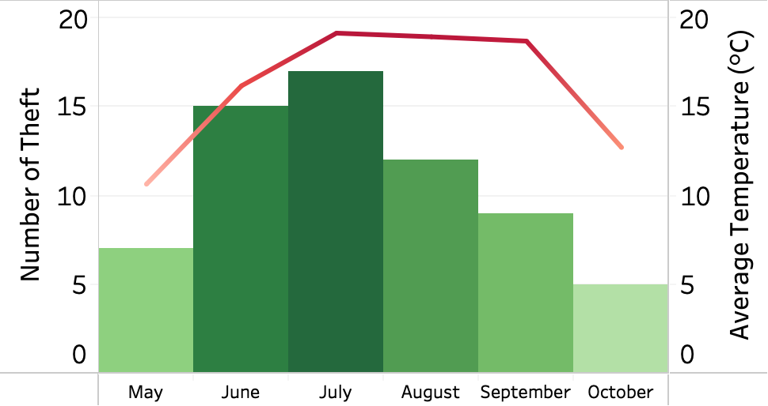
BIKE THEFT RECORD
2017
Highest Average Monthly Temperature
~19ºC
Source: [1]City of Fredericton and [2]Government of Canada

Slide 11


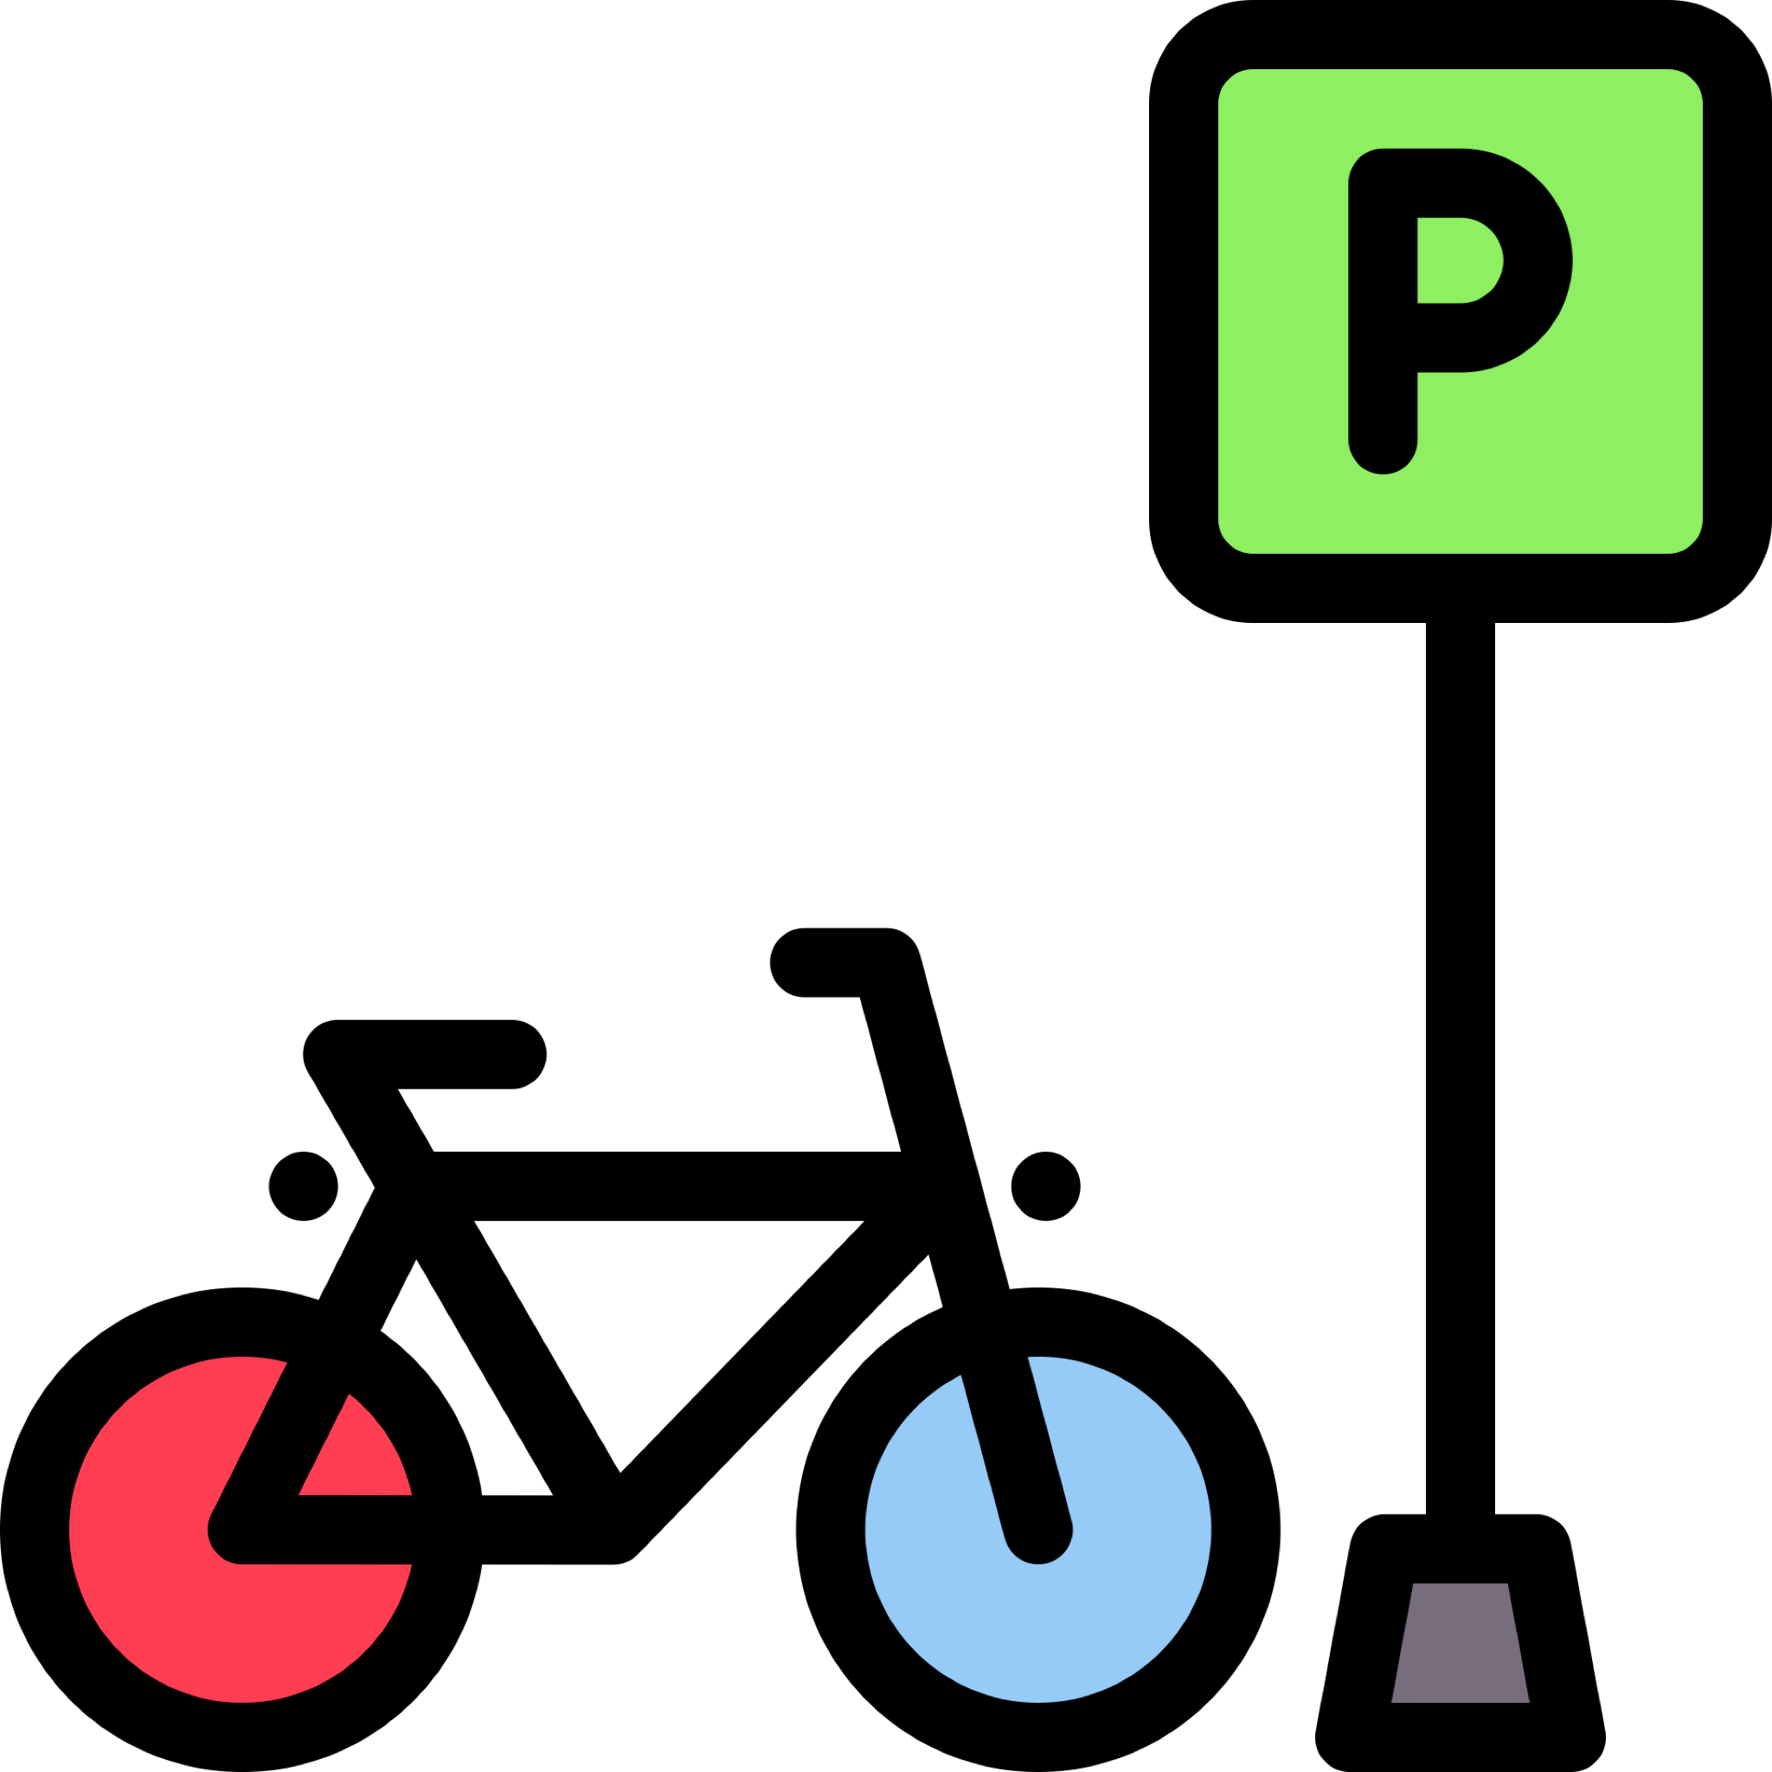
Recommendations
CONTINUE
Police enforcement of bike safety laws
IMPROVE
Bike Rack Safety
BUILD
Signalized Intersections
INCREASE
Police patrols during summer session
EDUCATE
Residents about sharing roads and streets
IMPLEMENT
Affordable bike insurance for bikers
Credits: All icons are made by Freepik from www.flaticon.com

Slide 12

Green and Healthy
Becoming less car-reliant

